Slide 1
Unit B Essential Synthesis

Slide 2
Statistic vs Parameter
A sample statistic is a number computed from sample data.
A population parameter is a number that describes some aspect of a population
Statistical inference is the process of drawing conclusions about the entire population based on information in a sample

Slide 3
Sampling Distribution
A sampling distribution is the distribution of statistics computed for different samples of the same size taken from the same population
The spread of the sampling distribution helps us to assess the uncertainty in the sample statistic
In real life, we rarely get to see the sampling distribution – we usually only have one sample

Slide 4
Bootstrap
A bootstrap sample is a random sample taken with replacement from the original sample, of the same size as the original sample
A bootstrap statistic is the statistic computed on the bootstrap sample
A bootstrap distribution is the distribution of many bootstrap statistics

Slide 5
BootstrapSample
Bootstrap Statistic
BootstrapSample
Bootstrap Statistic
Original Sample
Bootstrap Distribution
.
.
.
.
.
.
Sample Statistic
BootstrapSample
Bootstrap Statistic

Slide 6
Confidence Interval
A confidence interval for a parameter is an interval computed from sample data by a method that will capture the parameter for a specified proportion of all samples
A 95% confidence interval will contain the true parameter for 95% of all samples

Slide 7
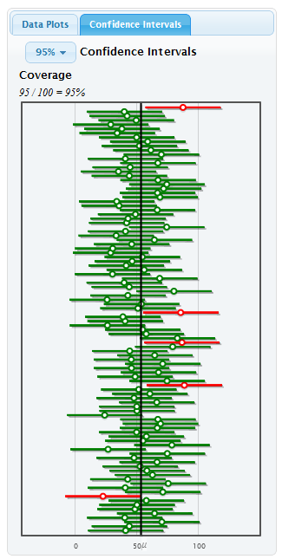
Confidence Intervals
The parameter is fixed
The statistic is random (depends on the sample)
The interval is random (depends on the statistic)
95% of 95% confidence intervals will capture the truth

Slide 8
Margin of Error
One common form for a confidence interval is
statistic ± margin of error
The margin of error is determined by the uncertainty in the sample statistic…
which depends on how much the statistic varies from sample to sample…
which is measured by the standard error

Slide 9
Standard Error
The standard error (SE) is the standard deviation of the sample statistic
The SE can be estimated by the standard deviation of the bootstrap distribution
For symmetric, bell-shaped distributions, a 95% confidence interval is

Slide 10
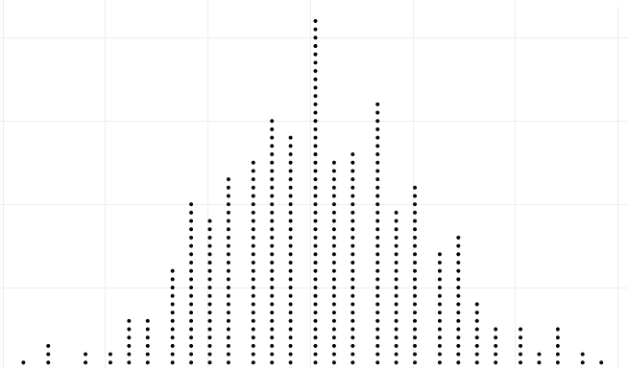
Confidence Intervals
Confidence Interval
statistic ± ME
Sample
Bootstrap Sample
Bootstrap Sample
Bootstrap Sample
. . .
Bootstrap Sample
Margin of Error (ME)
(95% CI: ME = 2×SE)
Bootstrap Sample
Bootstrap Distribution
Calculate statistic for each bootstrap sample
Standard Error (SE): standard deviation of bootstrap distribution

Slide 11
Percentile Method
If the bootstrap distribution is approximately symmetric, a P% confidence interval can be gotten by taking the middle P% of a bootstrap distribution

Slide 12
Bootstrap Distribution

Slide 13
Hypothesis Testing
How unusual would it be to get results as extreme (or more extreme) than those observed, if the null hypothesis is true?
If it would be very unusual, then the null hypothesis is probably not true!
If it would not be very unusual, then there is not evidence against the null hypothesis

Slide 14
p-value
The p-value is the probability of getting a statistic as extreme (or more extreme) as that observed, just by random chance, if the null hypothesis is true
The p-value measures evidence against the null hypothesis

Slide 15
Randomization Distribution
A randomization distribution is the distribution of sample statistics we would observe, just by random chance, if the null hypothesis were true
The p-value is calculated by finding the proportion of statistics in the randomization distribution that fall beyond the observed statistic

Slide 16
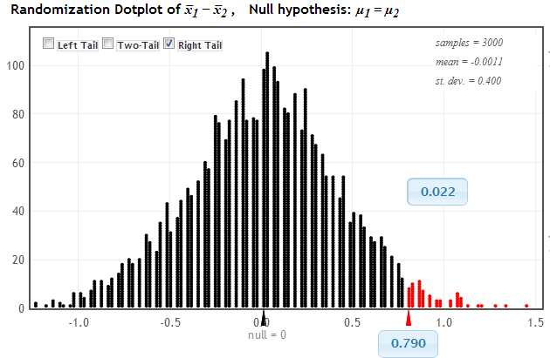
Hypothesis Testing
p-value
Observed Statistic

Slide 17
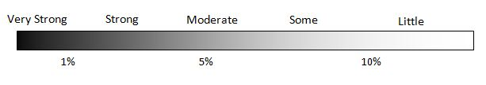
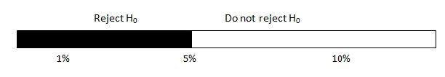
Statistical Conclusions
Strength of evidence against H₀:
Formal decision of hypothesis test, based on α = 0.05 :

Slide 18
Formal Decisions
For a given significance level, α,
p-value < α ⇒ Reject H_{o}
p-value > α ⇒ Do not Reject H_{o}

Slide 19
Formal Decisions
“If the p-value is low, the ho must go”

Slide 20
Errors
Decision
 | Reject H₀ | Do not reject H₀
H₀ true
H₀ false
TYPE I ERROR
☺
Truth
☺
TYPE II ERROR

Slide 21
Synthesis
You’ve now learned how to successfully collect and analyze data to answer a question!
Let’s put that to use…

Slide 22
Spend the rest of class on examples
Suggestions:
Examples from Unit B Essential Synthesis if students don’t read the book
Exercises from Unit B Essential Synthesis
The following two examples

Slide 23

Tongue Curling
What proportion of people can roll their tongue?
Can you roll your tongue? (a) Yes (b) No
Visualize and summarize the data. What is your point estimate?
Give and interpret a confidence interval.
Tongue rolling has been said to be a dominant trait, in which case theoretically 75% of all people should be able to roll their tongues. Do our data provide evidence otherwise?

Slide 24


Exercise and Pulse
Does just 5 seconds of exercise increase pulse rate?
What are the cases and variables? Are they categorical or quantitative? Identify explanatory and response.
Does the question imply causality? How would you collect data to answer it?
Merge with 3 other groups to collect data. (check pulse rate)
Visualize and summarize your data. Before doing any formal inference, take a guess at answering the question.
Conduct a hypothesis test to answer the question. State your hypotheses, calculate the p-value, make a conclusion in context.
How much does 5 seconds of exercise increase pulse rate by? State the parameter of interest and give and interpret a confidence interval.

Slide 25
QUESTIONS???

